Slide 1
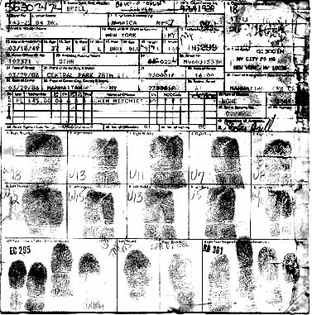
Fingerprints
Minutiae

Slide 2
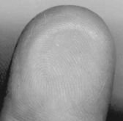
Review: Fingerprint Principles
According to criminal investigators, fingerprints follow 3 fundamental principles:
A fingerprint is an individual characteristic; no two people have been found with the exact same fingerprint pattern.
A fingerprint pattern will remain unchanged for the life of an individual.
Fingerprints have general characteristic ridge patterns that allow them to be systematically identified.

Slide 3
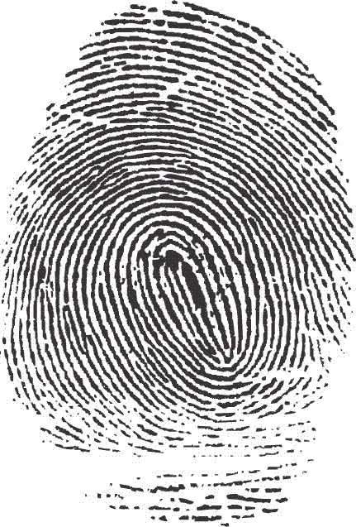
3 Fingerprint Classes
There are 3 specific classes for all fingerprints based
upon their visual pattern: arches, loops, and whorls.
Each group is divided into smaller groups as seen in the list below.
Arch
Plain arch
Tented arch
Loop
Radial Loop
Ulnar loop
Whorl
Plain whorl
Central pocket loop
Double loop
Accidentical

Slide 4
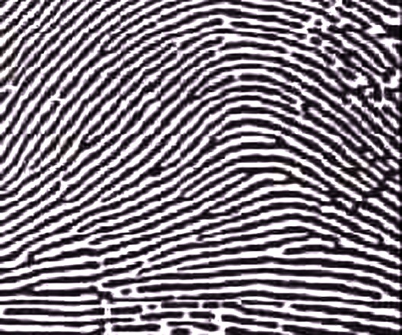
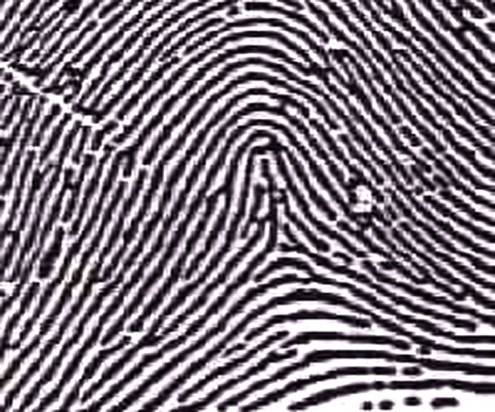
Arches
Arches are the simplest type of fingerprints that are formed by ridges that enter on one side of the print and exit on the other. No deltas are present.
Spike or “tent”
Plain Arch
Ridges enter on one side and
exit on the other side.
Tented Arches
Similar to the plain arch,
but has a spike in the center.

Slide 5
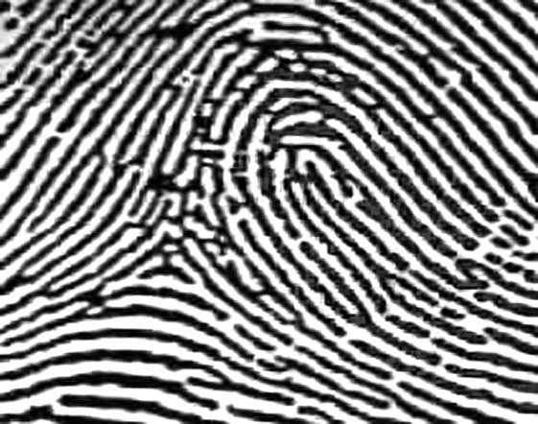
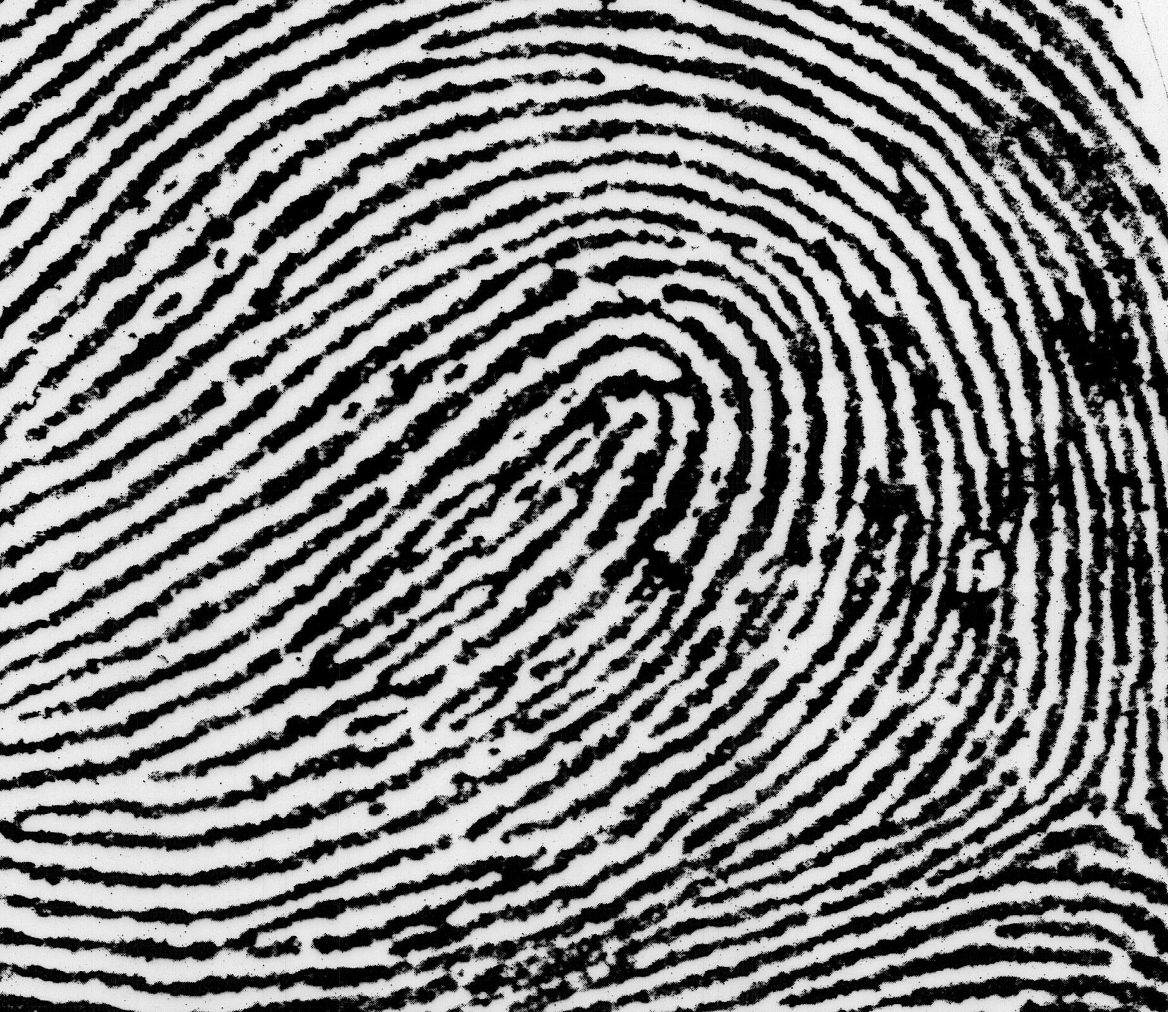
Loops
Loops must have one delta and one or more ridges that enter and leave on the same side. These patterns are named for their positions related to the radius and ulna bones.
Radial Loop (Right Hand)
Loop opens toward the thumb (or radius).
Delta
Ulnar Loop (Right Hand)
Loop opens toward the little finger (or ulna).
Delta

Slide 6
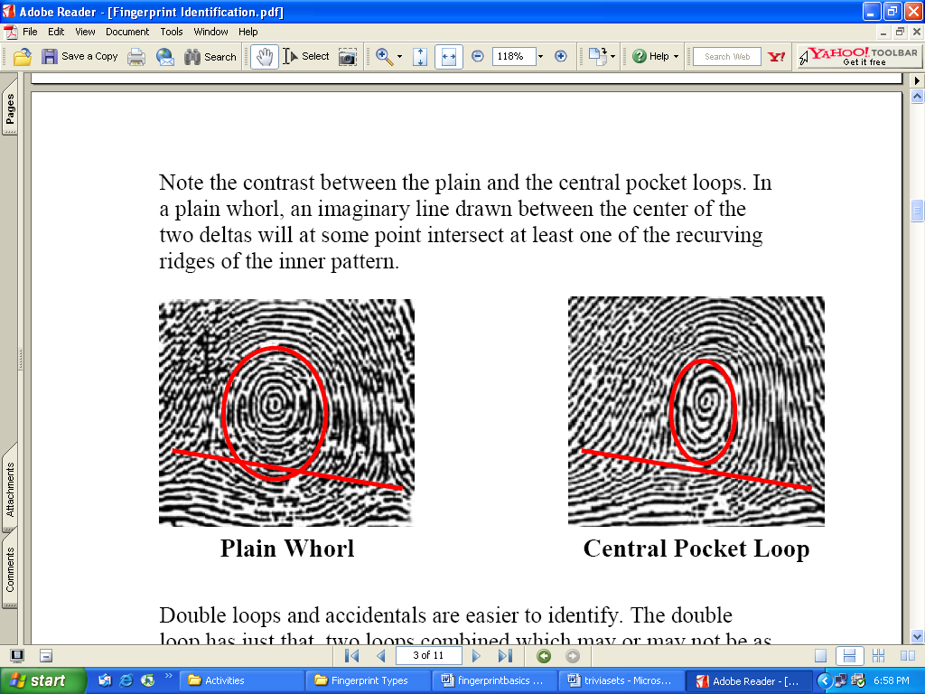
Whorls
Whorls have at least one ridge that makes (or tends to make) a complete circuit. They also have at least two deltas. If a print has more than two deltas, it is most likely an accidental.
Central Pocket Whorl
Plain Whorl
Draw a line between the two deltas in the plain and central pocket whorls. If some of the curved ridges touch the line, it is a plain whorl. If none of the center core touches the line, it is a central pocket whorl.

Slide 7
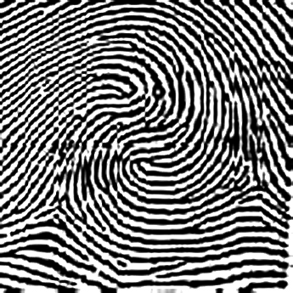
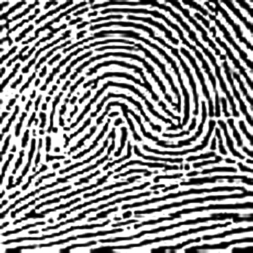
Whorls – Part 2
Double Loop Whorl
Accidental Whorl
Delta
Delta
Double loop whorls are made up of any two loops combined into one print.
Accidental whorls contain two or more patterns (not including the plain arch), or does not clearly fall under any of the other categories.

Slide 8
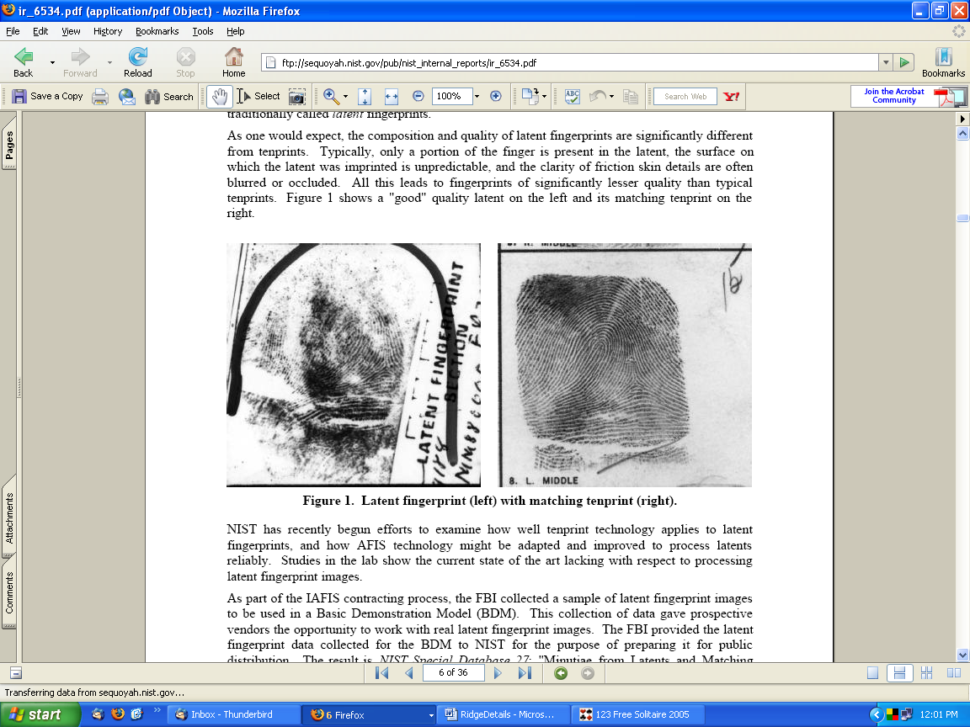
Ridgeology
A Closer Look at Fingerprints
T. Trimpe 2007 http://sciencespot.net/

Slide 9
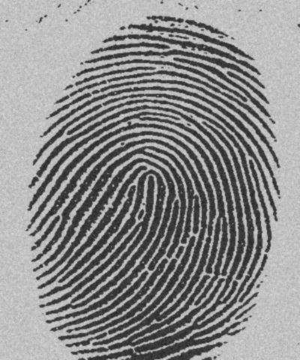
Ridges & Valleys
What is a ridge?
Raised section of fingerprint detail
What is a valley?
Indented section of fingerprint detail

Slide 10
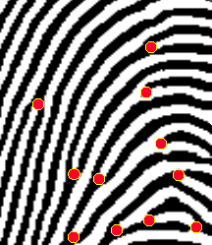
Ridgeology: The study of the uniqueness of friction ridge structures and their use for personal identification.
A fingerprint is made of a series of ridges and valleys on the surface of the finger. The uniqueness of a fingerprint can be determined by the pattern of ridges and valleys as well as the minutiae points, which are points where the ridge structure changes.
Did you know?
The koala is one of the few mammals (other than primates) that has fingerprints. In fact, koala fingerprints are remarkably similar to human fingerprints; even with an electron microscope, it can be quite difficult to distinguish between the two.

Slide 11
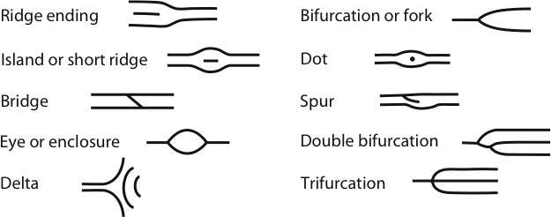
Ridge Characteristics
Minutiae—characteristics of ridge patterns
Ridge ending
Short ridge
Dot or fragment
Bifurcation
Double bifurcation
Trifurcation
Bridge
Island
Enclosure
Spur

Slide 12
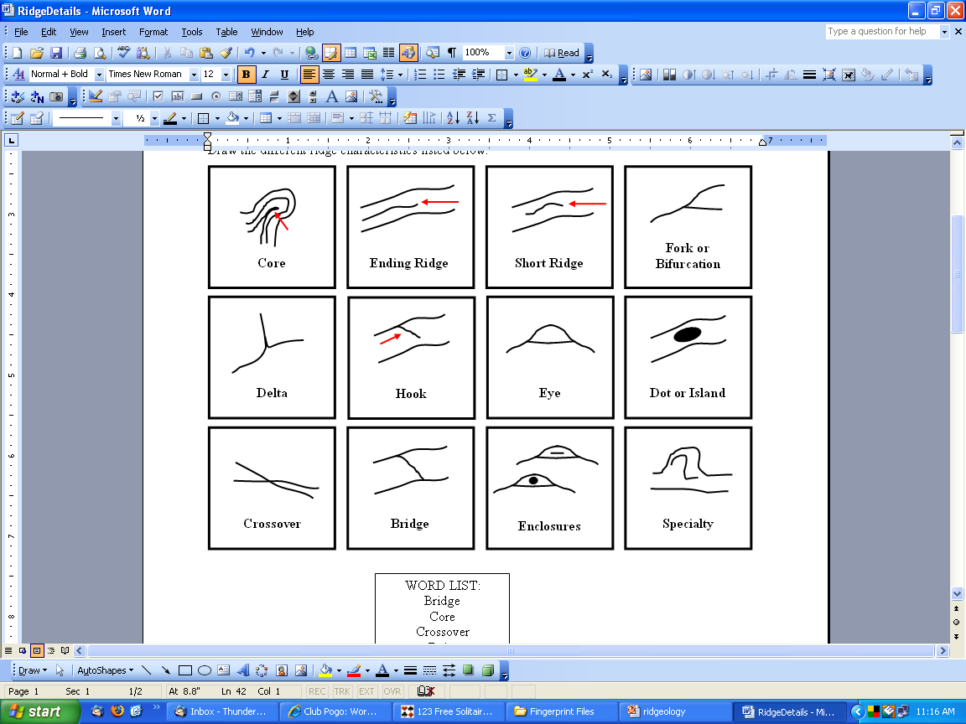
Ridge Characteristics

Slide 13
Ridge Characteristics

Slide 14
Ridge Characteristics

Slide 15
Ridge Characteristics

Slide 16
Ridge Characteristics

Slide 17
Ridge Characteristics

Slide 18
Ridge Characteristics

Slide 19
Ridge Characteristics

Slide 20
Ridge Characteristics

Slide 21
Ridge Characteristics

Slide 22
Ridge Characteristics

Slide 23
Ridge Characteristics

Slide 24
Ridge Characteristics

Slide 25
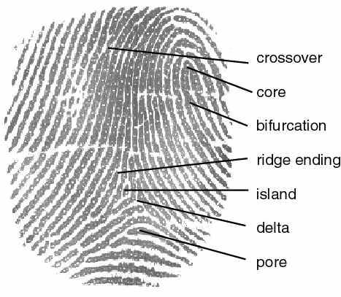
Examples of Ridge Characteristics
Crossover
Core
Bifurcation (fork)
Ridge ending
Scar
Island
Delta
Pore
http://cnx.org/content/m12574/latest/properties.jpg

Slide 26
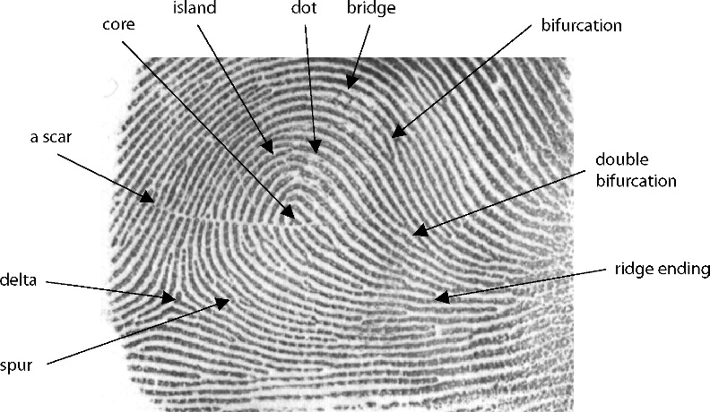
Fingerprint Minutiae

Slide 27
How many ridge characteristics can you identify in this fingerprint?

Slide 28
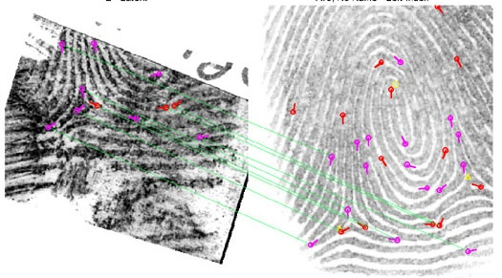
Fingerprint Identification
When minutiae on two different prints match, these are called points of similarity or points of identification. At this point there is no international standard for the number of points of identification required for a match between two fingerprints. However, the United Kingdom requires a minimum sixteen points while Australia requires twelve.
Automated Fingerprint Identification System (AFIS)
AFIS is a computerized system capable of reading, classifying, matching, and storing fingerprints for criminal justice agencies. Quality latent fingerprints are entered into the AFIS for a search for possible matches against the state maintained databases for fingerprint records to help establish the identity of unknown deceased persons or suspects in a criminal case.

Slide 29




Fingerprints
How are fingerprints analyzed?
Minutiae
Bifurcation
Ridge Ending
Dot
Island

Slide 30
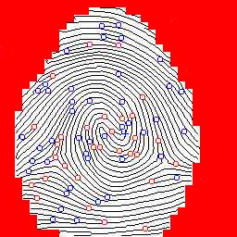
Computer software compares the location of these minutiae.

Slide 31
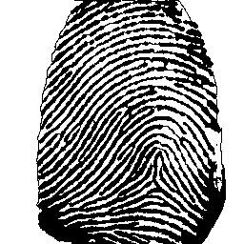
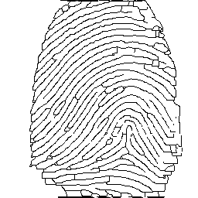
Spurious Regions
Edge Gaps

Slide 32
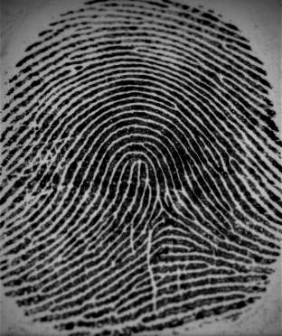
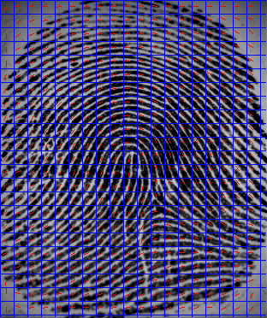
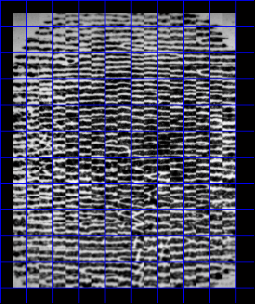
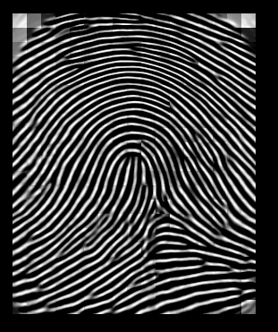
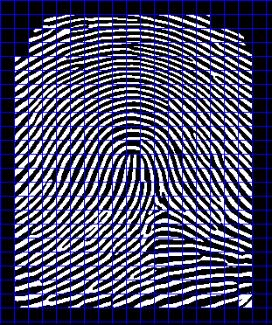
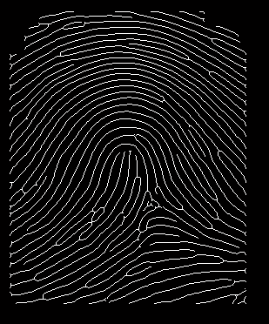
FP Image
Orientation Field
Ridge Frequency
Adaptive Filter
Binarized Image
Thinned Image

Slide 33
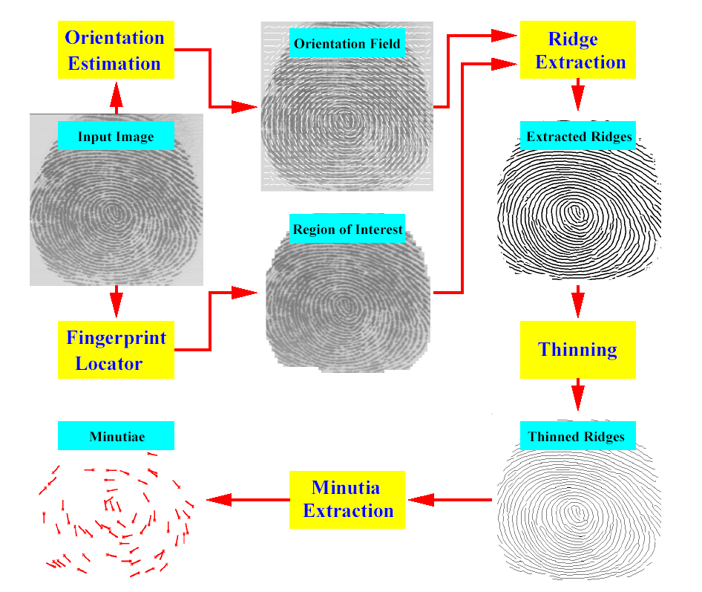
Minutia extraction algorithm

Slide 34
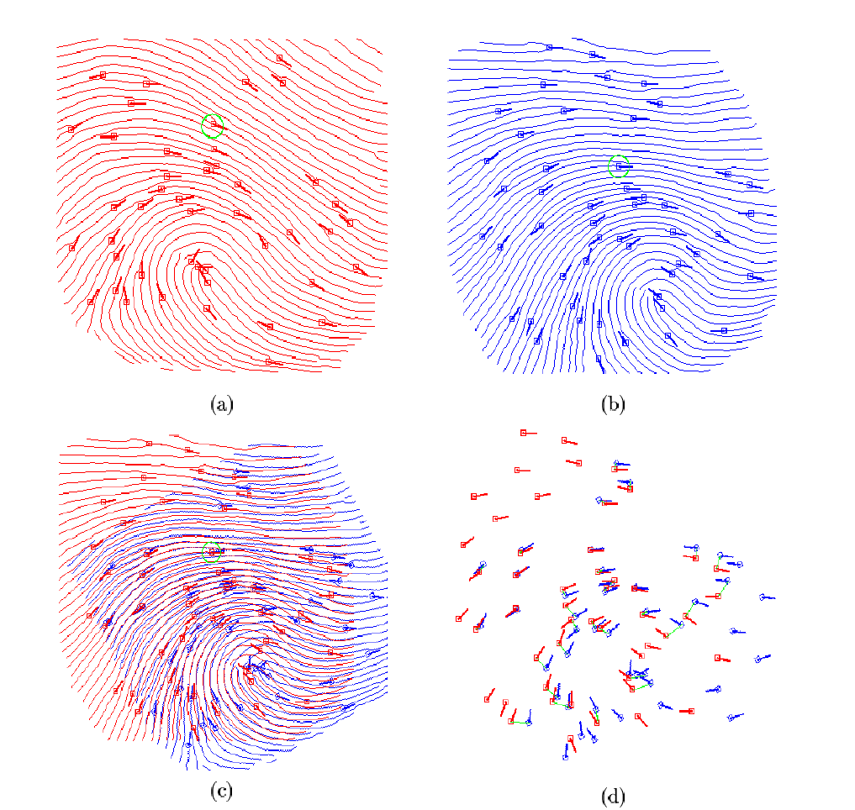

Slide 35
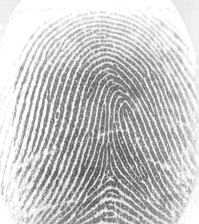
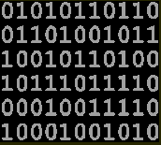
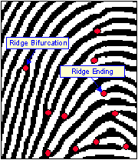
What is a Template ?
Template
Raw image
Feature extraction - locate minutiae
Template
  contains the extracted unique features of biometric data
  shows geometric relationship between minutiae
Notes:
Non è possibile fare autenticazione sicura se questa è basata su informazioni pubbliche o facilmente ricavabili oppure riproducibili in momenti diversi
L’autenticazione biometrica è sicura se è possibile garantire l’irripetibilità e l’univocità dell’atto di acquisizione dei parametri personali al momento dell’identificazione
Successively recorded fingerprints are never identical, rather are at best highly 'similar' due to differences in finger position, application pressure, finger angle, dirtiness, and the physiological constitution of the user. The measure of similarity is given a score. The higher this score, the more similar the fingerprint, and vice versa. During the matching process in minutia based systems, one tries to minimize the influence of positioning and angle discrepancy, and incidentally size variations (in order to calculate out the effects of growth until around 18 years). The actual picture is adjusted and rotated with respect to the reference picture until the distance between minutia is minimized. The resulting similarity score, then depends on the following:
Number of minutia in agreement
Exactness of the positioning agreement
Degree of agreement of the minutia directions
Type of minutia agreement (line ending versus branching)
All values will be weighted with the picture quality near a minutia
Basically one can say that few, but very strongly matching minutia can receive a similar score as a case with many, but weakly matching minutia.

Slide 36
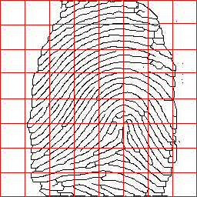
Scanning Image

Slide 37
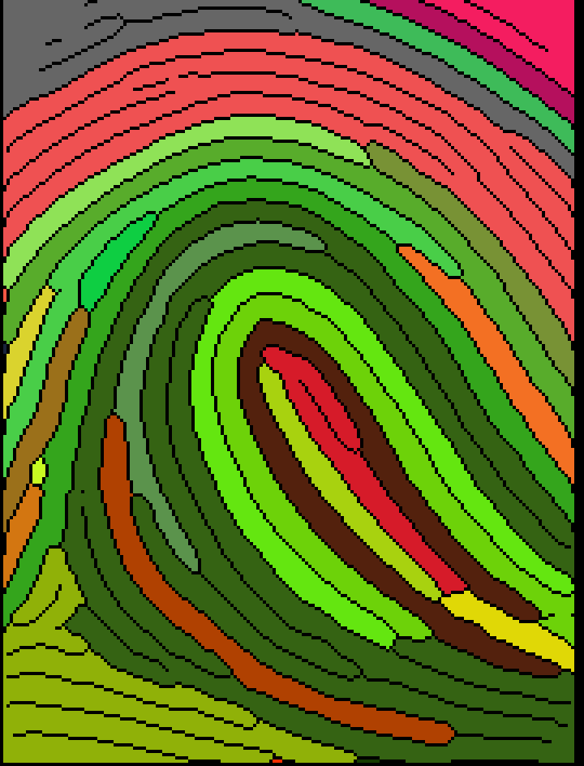
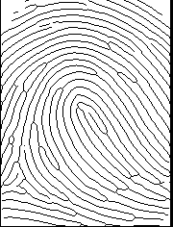
Region Coloring

Slide 38
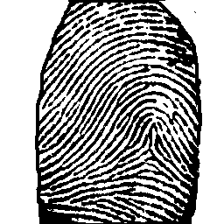
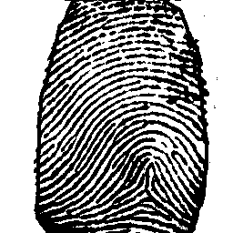
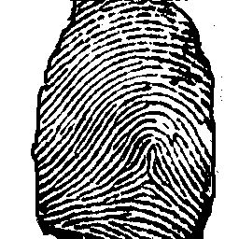
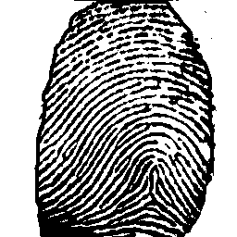
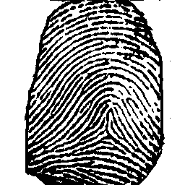
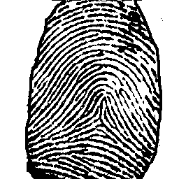
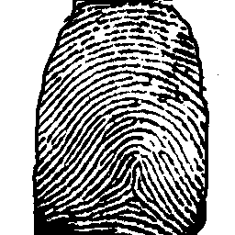
Input Fingerprints

Slide 39
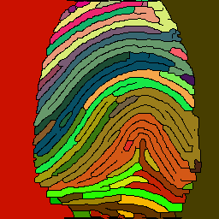
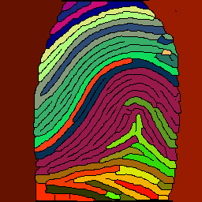
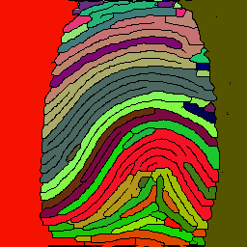
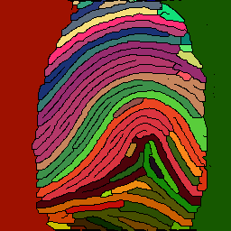
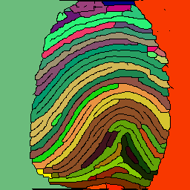
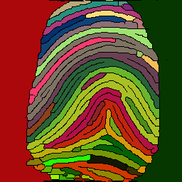
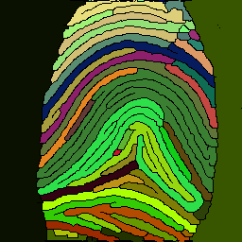
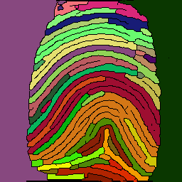
Output of Program

Slide 40

Minutiae Pair 1

Slide 41

Minutiae Pair 2

